Slide 1
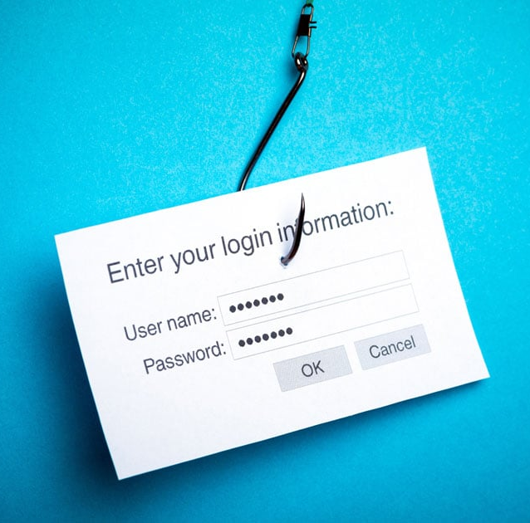

PHISHING

Slide 2

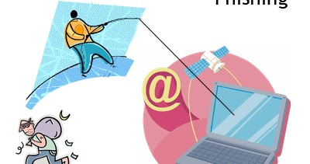

PHISHING TYPES
Email Phishing
Spear Phishing
Whaling
Smishing and Vishing
This Photo by Unknown author is licensed under CC BY-SA-NC.

Slide 3

EMAIL PHISHING
Email phishing involves fraudulent emails aiming to obtain sensitive information. Beware of suspicious links and requests from seemingly legitimate sources to prevent identity theft and financial loss

Slide 4

SPEAR PHISHING
Spear phishing targets specific individuals or organizations with personalized messages to trick them into revealing confidential information or installing malware. Stay vigilant.

Slide 5

WHALING
Whaling in phishing refers to targeted attacks on high-profile individuals or organizations to steal sensitive information or money through deceptive emails or websites.

Slide 6



SMISHING AND VISHING
Smishing involves fraudulent text messages aimed at tricking individuals into divulging personal information, while vishing uses phone calls to deceive victims into revealing sensitive data or performing actions against their interest

Slide 7
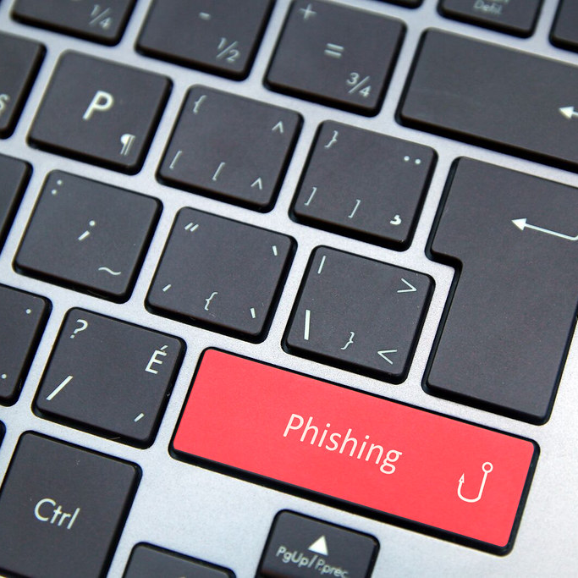
To evade phishing, scrutinize unsolicited emails, confirm sender legitimacy, avoid clicking on dubious links or attachments, and update security software regularly. Implement multi-factor authentication, educate yourself and others about phishing tactics, and be wary of urgent requests for personal or financial information, especially if they evoke fear or urgency.
This Photo by Unknown author is licensed under CC BY.

